Slide 1
Functional Dependencies and Normalization for Relational Databases

Slide 2
Lesson Outline
1 Informal Design Guidelines for Relational Databases
  Semantics of the Relation Attributes
  Redundant Information in Tuples and Update Anomalies
  Null Values in Tuples
  Spurious Tuples
Functional Dependencies (FDs)
Normalisation and Normal Forms

Slide 3
Informal Design Guidelines for Relational Databases (1)
What is relational database design?
  The grouping of attributes to form "good" relation schemas
Two levels of relation schemas
  The logical "user view" level
  The storage "base relation" level
Design is concerned mainly with base relations
What are the criteria for "good" base relations?

Slide 4
Semantics of the Relation Attributes
GUIDELINE 1:
Informally, each tuple in a relation should represent one entity or relationship instance. (Applies to individual relations and their attributes).
  Attributes of different entities (EMPLOYEEs, DEPARTMENTs, PROJECTs) should not be mixed in the same relation

Slide 5
Semantics of the Relation Attributes
  Only foreign keys should be used to refer to other entities
  Entity and relationship attributes should be kept apart as much as possible
Bottom Line: Design a schema that can be explained easily relation by relation. The semantics of attributes should be easy to interpret.

Slide 6
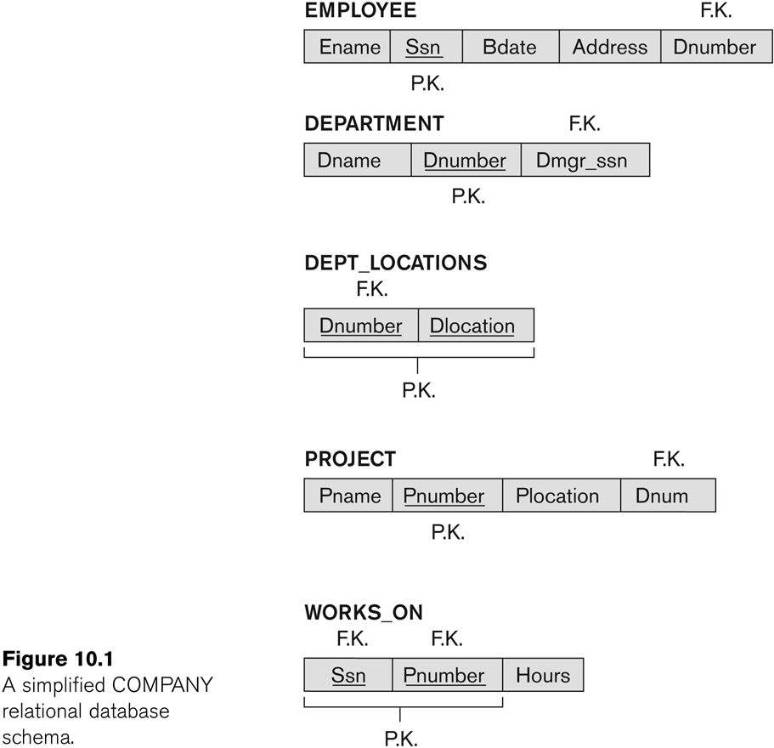
Figure 7.1 A simplified COMPANY relational database schema

Slide 7
Redundant Information in Tuples and Update Anomalies
Information is stored redundantly
  Wastes storage
  Causes problems with update anomalies
    Insertion anomalies
    Deletion anomalies
    Modification anomalies

Slide 8
EXAMPLE OF AN UPDATE ANOMALY
Consider the relation:
  EMP_PROJ(Emp#, Proj#, Ename, Pname, No_hours)
Update Anomaly:
  Changing the name of project number P1 from “Billing” to “Customer-Accounting” may cause this update to be made for all 100 employees working on project P1.

Slide 9
EXAMPLE OF AN INSERT ANOMALY
Consider the relation:
  EMP_PROJ(Emp#, Proj#, Ename, Pname, No_hours)
Insert Anomaly:
  Cannot insert a project unless an employee is assigned to it.
Conversely
  Cannot insert an employee unless he/she is assigned to a project.

Slide 10
EXAMPLE OF AN DELETE ANOMALY
Consider the relation:
  EMP_PROJ(Emp#, Proj#, Ename, Pname, No_hours)
Delete Anomaly:
  When a project is deleted, it will result in deleting all the employees who work on that project.
  Alternately, if an employee is the sole employee on a project, deleting that employee would result in deleting the corresponding project.

Slide 11
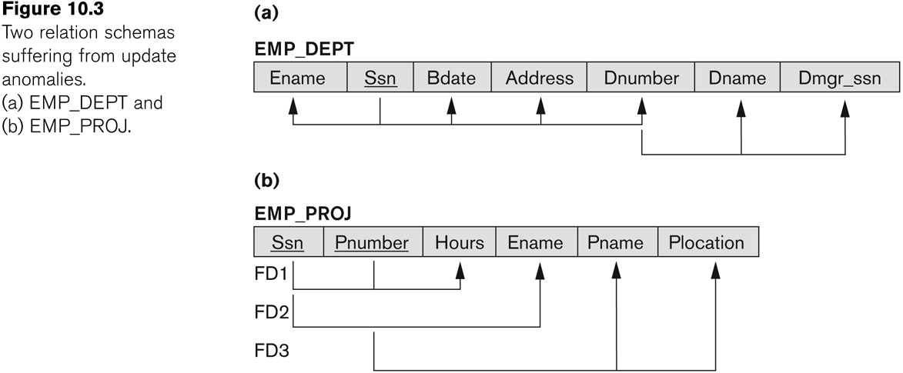
Figure 7.3 Two relation schemas suffering from update anomalies

Slide 12
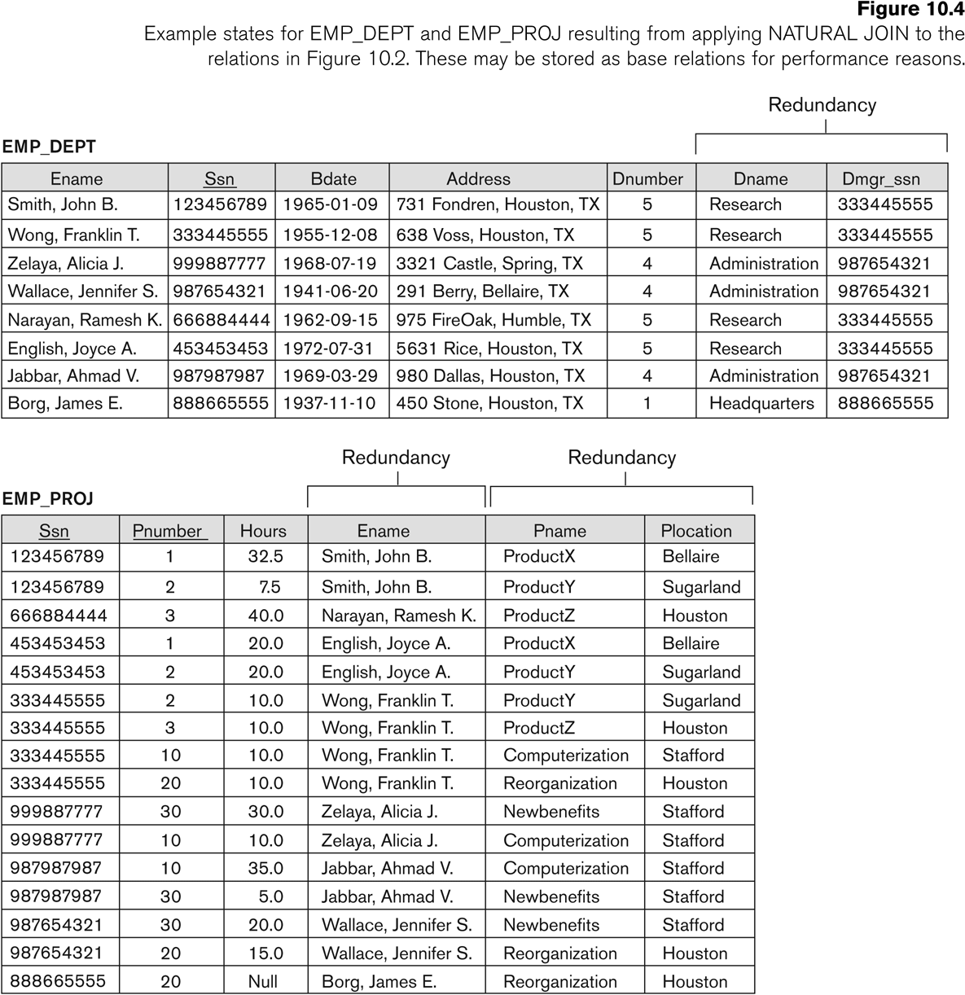
Figure 7.4 Example States for EMP_DEPT and EMP_PROJ

Slide 13
Guideline to Redundant Information in Tuples and Update Anomalies
GUIDELINE 2:
  Design a schema that does not suffer from the insertion, deletion and update anomalies.
  If there are any anomalies present, then note them so that applications can be made to take them into account.

Slide 14
Null Values in Tuples
GUIDELINE 3:
  Relations should be designed such that their tuples will have as few NULL values as possible
  Attributes that are NULL frequently could be placed in separate relations (with the primary key)
Reasons for nulls:
  Attribute not applicable or invalid
  Attribute value unknown (may exist)
  Value known to exist, but unavailable

Slide 15
Spurious Tuples
Bad designs for a relational database may result in erroneous results for certain JOIN operations

Slide 16
GUIDELINE 4:
Design relation schemas so that they can be joined with equality conditions on attributes that are (primary key, foreign key) pairs in a way that guarantees that no spurious tuples are generated
Avoid relations that contain matching attributes that are not (foreign key, primary key) combinations because joining on such attributes my produce spurious tuples.

Slide 17
Functional Dependencies (1)
Functional dependencies (FDs)
  Are used to specify formal measures of the "goodness" of relational designs
  And keys are used to define normal forms for relations
  Are constraints that are derived from the meaning and interrelationships of the data attributes
A set of attributes X functionally determines a set of attributes Y if the value of X determines a unique value for Y

Slide 18
Functional Dependencies (2)
X -> Y holds if whenever two tuples have the same value for X, they must have the same value for Y
  For any two tuples t1 and t2 in any relation instance r(R): If t1[X]=t2[X], then t1[Y]=t2[Y]
X -> Y in R specifies a constraint on all relation instances r(R)
Written as X -> Y; can be displayed graphically on a relation schema as in Figures. ( denoted by the arrow: ).
FDs are derived from the real-world constraints on the attributes

Slide 19
Examples of FD constraints (1)
Social security number determines employee name
  SSN -> ENAME
Project number determines project name and location
  PNUMBER -> {PNAME, PLOCATION}
Employee ssn and project number determines the hours per week that the employee works on the project
  {SSN, PNUMBER} -> HOURS

Slide 20
Examples of FD constraints (2)
An FD is a property of the attributes in the schema R
The constraint must hold on every relation instance r(R)
If K is a key of R, then K functionally determines all attributes in R
  (since we never have two distinct tuples with t1[K]=t2[K])

Slide 21
Full Functional Dependency
Full functional dependency applies to tables with composite keys.
Column Y in relational table R is fully functional on X of R if it is functionally dependent on X and not functionally dependent upon any subset of X.

Slide 22
Full Functional Dependency(1)
Full functional dependence means that when a primary key is composite, made of two or more columns, then the other columns must be identified by the entire key and not just some of the columns that make up the key.

Slide 23
Normalization of Relations
Normalization:
  The process of decomposing unsatisfactory "bad" relations by breaking up their attributes into smaller relations
Normal form:
  Condition using keys and FDs of a relation to certify whether a relation schema is in a particular normal form

Slide 24
Definitions of Keys and Attributes Participating in Keys (1)
A superkey of a relation schema R = {A1, A2, ...., An} is a set of attributes S subset-of R with the property that no two tuples t1 and t2 in any legal relation state r of R will have t1[S] = t2[S]
A key K is a superkey with the additional property that removal of any attribute from K will cause K not to be a superkey any more.

Slide 25
Definitions of Keys and Attributes Participating in Keys
If a relation schema has more than one key, each is called a candidate key.
  One of the candidate keys is arbitrarily designated to be the primary key, and the others are called secondary keys.
A Prime attribute must be a member of some candidate key
A Nonprime attribute is not a prime attribute—that is, it is not a member of any candidate key.

Slide 26


Normalization into 1NF

Slide 27
FIRST NORMAL FORM
The domain of Dlocations contains atomic values, but some tuples can have a set of these values. In this case, Dlocations is not functionally dependent on the primary key Dnumber.
The domain of Dlocations contains sets of values and hence is nonatomic. In this case, Dnumber Dlocations because each set is considered a single member of the attribute domain.

Slide 28
Techniques To Achieve First Normal Form
Remove the attribute Dlocations that violates 1NF and place it in a separate relation DEPT_LOCATIONS along with the primary key Dnumber of DEPARTMENT. The primary key of this relation is the combination {Dnumber, Dlocation}, as shown in Figure 4.3.
A distinct tuple in DEPT_LOCATIONS exists for each location of a department. This decomposes the non-1NF relation into two 1NF relations.

Slide 29
Techniques To Achieve First Normal Form(2)
Expand the key so that there will be a separate tuple in the original DEPARTMENT relation for each location of a DEPARTMENT, as shown in Figure 7.6( c). In this case,
the primary key becomes the combination {Dnumber, Dlocation}. This solution has the disadvantage of introducing redundancy in the relation.

Slide 30
Techniques To Achieve First Normal Form(3)
If a maximum number of values is known for the attribute – for example, if it is known that at most three locations can exist for a department, replace the Dlocations attribute by three atomic attributes: Dlocation1, Dlocation2, and Dlocation3.
This solution has the disadvantage of introducing NULL values if most departments have fewer than three locations. Querying on this attribute also becomes difficult.

Slide 31
Second Normal Form (1)
Uses the concepts of FDs, primary key
Definitions
  Prime attribute: An attribute that is member of the primary key K
  Full functional dependency: a FD Y -> Z where removal of any attribute from Y means the FD does not hold any more
Examples:
  {SSN, PNUMBER} -> HOURS is a full FD since neither SSN -> HOURS nor PNUMBER -> HOURS hold
  {SSN, PNUMBER} -> ENAME is not a full FD (it is called a partial dependency ) since SSN -> ENAME also holds

Slide 32
Second Normal Form(2)
A relation schema R is in second normal form (2NF) if every non-prime attribute A in R is fully functionally dependent on the primary key
R can be decomposed into 2NF relations via the process of 2NF normalization

Slide 33
Second Normal Form

Slide 34
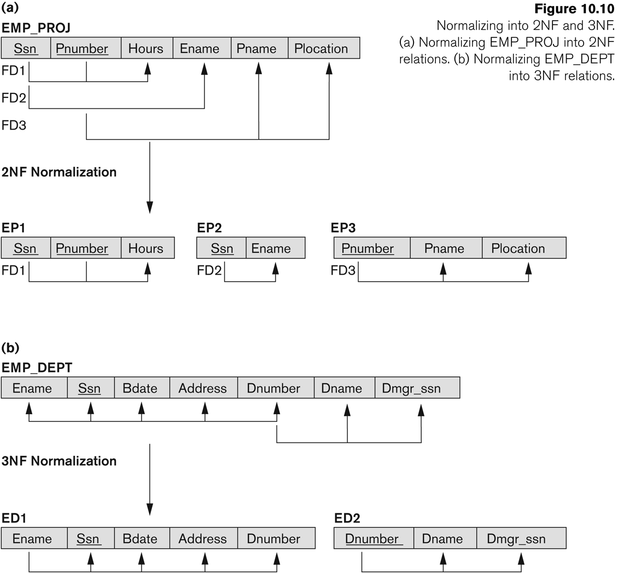
Normalizing into 2NF and 3NF

Slide 35
Third Normal Form(1)
Definition:
  Transitive functional dependency: a FD X -> Z that can be derived from two FDs X -> Y and Y -> Z
Examples:
  SSN -> DMGRSSN is a transitive FD
    Since SSN -> DNUMBER and DNUMBER -> DMGRSSN hold
  SSN -> ENAME is non-transitive
    Since there is no set of attributes X where SSN -> X and X -> ENAME

Slide 36
Third Normal Form(2)
A relation schema R is in third normal form (3NF) if it is in 2NF and no non-prime attribute A in R is transitively dependent on the primary key
R can be decomposed into 3NF relations via the process of 3NF normalization
NOTE:
  In X -> Y and Y -> Z, with X as the primary key, we consider this a problem only if Y is not a candidate key.
  When Y is a candidate key, there is no problem with the transitive dependency .
  E.g., Consider EMP (SSN, Emp#, Salary ).
    Here, SSN -> Emp# -> Salary and Emp# is a candidate key.

Slide 37
Summary of Normal Forms Based on Primary Keys and Corresponding Normalisation
Normal Form | Test | Remedy (Normalisation)
First (1NF) | Relation should have no multivalued or nested relations. | Form new relations for each multivalued attribute or nested relationsl
Second (2NF) | For relations where primary key contains multiple attributes, no nonkey attribute should be functionally dependent on a part of the primary key. | Decompose and set up a new relation for each partial key with its dependent attribute(s). Make sure to keep a relation with the original primary key and any attributes that are fully functionally dependent on it.
Third (3NF) | Relation should not have a nonkey attribute functionally determined by another nonkey attribute (or by a set of nonkey attributes). That is, there should be no transitive dependency of a nonkey attribute on the primary key. | Decompose and set up a relation that includes the nonkey attribute(s) that functionally determine(s) other nonkey attribute(s).

Slide 38
End

